Slide 1
Be SMART is a program developed by Everytown for Gun Safety Support Fund to bring together parents and all adults concerned about kids, guns, and safety.
BeSMARTforkids.org
BeSMARTforKids.org
Notes:
START OF PRESENTATION
SLIDE 1 - Be SMART is a program developed by Everytown for Gun Safety Support Fund to bring together parents and all adults concerned about kids, guns, and safety. Introduce yourself.

Slide 2
Welcome!
Parent Teacher Association
Patrick Henry Elementary School
Alexandria City Public Schools
December 6, 2022
Andrew Corso
Carrie Heath-Phillips
Co-Leads Alexandria Be SMART
BeSMARTforKids.org
Notes:
SLIDE 2 - Let’s take a minute to watch this short video (Aaron Donald PSA plays) - click the word welcome to play
NOTE - EDIT EVENT INFO AND DATE ON SLIDE

Slide 3
1
We all want kids to grow up happy and healthy.
We each have the right to make responsible decisions about how to protect our homes, families, and communities—including whether or not to have a gun in our home.
If we can prevent even one child gun death or injury, it’s our responsibility to do so.
2
3
BeSMARTforKids.org
Notes:
SLIDE 3 - Read the slide:
1. We all want kids to grow up happy and healthy.
2. We each have the right to make responsible decisions about how to protect our homes, families, and communities—including whether or not to have a gun in our home.
3. If we can prevent even one child gun death or injury, it’s our responsibility to do so.
We’re not here to talk about laws or policies, so let’s set those aside.

Slide 4
Be SMART is a program to bring together all adults concerned about kids, guns, and safety.
BeSMARTforKids.org
Notes:
SLIDE 4 - no notes; transition slide

Slide 5
Resources Contact Info
National Suicide Prevention Line
1 (800) 273-8255
(24 hours/day)
988 Suicide & Crisis Lifeline
can be reached by calling or texting 988, or chatting on http://988lifeline.org
Trevor Project
The LGBTQIA+ Youth Suicide Prevention Line
Trevor Lifeline
1 (866) 488-7386
Text “Home” to 741-741
From anywhere in the United States, anytime, about any type of crisis
BeSMARTforKids.org
Notes:
SLIDE 5 - We must break the silence around suicide. Here are some important resources to write down or take a picture of in case you or someone you care about needs help.
We have handout materials with more information about how to get help if you do recognize these and other warning signs and it includes the Suicide Prevention Hotline. (Handout optional.) Before we begin, we will be talking about stories of gun violence and suicide and we know living through these experiences is devastating and hearing about them can be difficult as well. If you need to step away during the session to care for yourself, please do. We will share resources at the end of this session to seek additional support if needed.

Slide 6
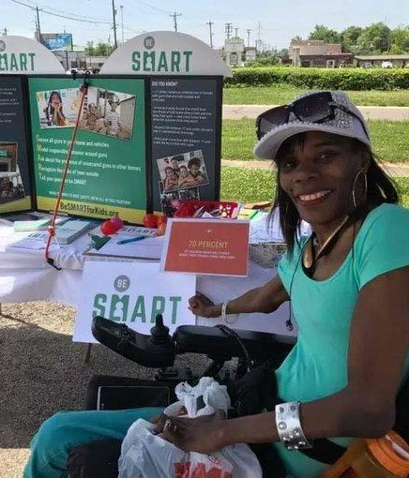
Local Partner
Presentation
Be SMART is an ideal presentation idea for schools, PTAs, churches, civic groups, training events, and neighborhood associations
BeSMARTforKids.org
Notes:
Notes: You can edit this or slides 9, 10, 11 or 12 to highlight your Local Partner Relationships and spend a few moments talking about that work, or use this example if this type of work is new in your community.

Slide 7
Firearms are the LEADING CAUSE of death for CHILDREN in the US.
BeSMARTforKids.org
Notes:
SLIDE 7 - It’s a heartbreaking fact that in the US, firearms are the leading cause of death for children. This is a public health crisis. More than 1,800 children under the age of 18 are killed with guns every year—an average of 5 children every day. When children are killed with guns, the majority of those deaths, 54 percent, are homicides—that’s 1,000 children per year. Additionally, nearly 700 children die by firearm suicide each year and 100 are unintentionally shot and killed. We’re here today to talk about how we can prevent tragedies like that.

Slide 8
In incidents of gunfire on school grounds, up to 76% of shooters under the age of 18 obtained the gun(s) they used from their home or the home of relatives or friends.
BeSMARTforKids.org
Notes:
SLIDE 8 - A shocking 4.6 million children in the US live in a household with at least one loaded, unlocked gun. While school shootings and mass shootings typically make national headlines, almost all child unintentional shooting deaths occur in the home. And the Secret Service found that three-quarters of school shooters acquired their firearm from the home of a parent or close relative.
So listen, I know this is an emotional issue, and we may come from different walks of life. Many of you may be parents, some of you may be gun owners and some of you may not be, some of you may have had a personal experience with guns, and some of you may have even been impacted by gun violence.
We believe that most gun owners want to be responsible gun owners, so we are here today to talk about what ALL of us, gun owners and non-gun owners alike can do to make sure children and teens do not have unsupervised access to guns.

Slide 9
An American Problem
Local 4 News Detroit
6 Action News Philadelphia
Sheriff: Oxford High School shooter used 9 mm pistol recently purchased by father
Teen accused of shooting, killing 3 students*, injuring 8 other people
*updated 4 dead, 7 injured
Officials: 3-year-old shot after being left alone in car with gun in Caln Township
Newsweek
ABC, Inc., KTRK-TV Houston
Loaded Gun Brought to Elementary School by 7-Year-Old Days After Uvalde: An investigation is underway at a Columbia, South Carolina, elementary school after a loaded handgun was found in the backpack of a 7-year-old student.
Two teenage boys are in the hospital after being shot in what investigators believe to be a murder-suicide attempt in the Spring area.
BeSMARTforKids.org
Notes:
SLIDE 9 - Instructions for volunteers:
Get updated local stories (Please take a look at Incorporating a Trauma Informed Approach to Stories and Links in Public Education Outreach prior to linking specific stories on these slides)
can insert from - https://everytownresearch.org/maps/notanaccident/
or search “accident” on https://momentsthatsurvive.org/stories/
or seach on https://everytownresearch.org/maps/gunfire-on-school-grounds/
or highlight a local incident
Notes: I want to take a few minutes to talk specifically about what the consequences of unsecured guns looks like in our community.
Talk candidly about 1-2 most recent incidents (school shooting, recent unintentional shooting)
Or use these sample incidents:
On this slide, you’ll see just a few headlines from stories from across the country, although we know there are many incidents that go unreported.
https://www.clickondetroit.com/news/local/2021/12/01/sheriff-oxford-high-school-shooter-used-9-mm-pistol-recently-purchased-by-father/
https://6abc.com/shooting-child-shot-toddler-accidental/12085972/
https://www.newsweek.com/loaded-gun-brought-elementary-school-7-year-old-days-after-uvalde-1710673
https://abc13.com/spring-teenage-boys-shot-attempted-murder-suicide-windrose-west-neighborhood-shots-fired-round-rose-court/12093027/
All four of these stories show the fallout of when young people get their hands on unsecured guns. No story is quite the same, but all are tragic and all are preventable.

Slide 10
S
M
A
R
T
Secure
Model
Ask
Recognize
Tell
All guns in your home and vehicle
Responsible behavior
Unsecured guns in other homes
The role of guns in suicide
Your peers to Be SMART
BeSMARTforKids.org
Notes:
SLIDE 10 - But we can all take action in our homes and our communities to keep our kids safe. So, even if you don’t have a gun in your home, or if you do and you know that you’re already practicing secure gun storage, what can you do right now?
Together we can learn to Be SMART!

Slide 11
S
Secure guns in homes and vehicles
13 million households with children contain at least one gun
One study found that the majority of children in gun-owning households knew where the gun was stored
Store guns locked up and inaccessible to kids
Hiding a gun is not “securing” a gun
BeSMARTforKids.org
Notes:
SLIDE 11 - Let’s start with “S”, Secure your guns in homes and vehicles.
13 million households with children contain at least one gun. And the majority of children in gun-owning households actually know where the gun is stored.
So what do I mean by securing guns?
A gun should always be stored securely, which means they are inaccessible to kids, and make sure children are never in the presence of unsecured guns. Remember, “hiding” a gun is NOT securing a gun.

Slide 12
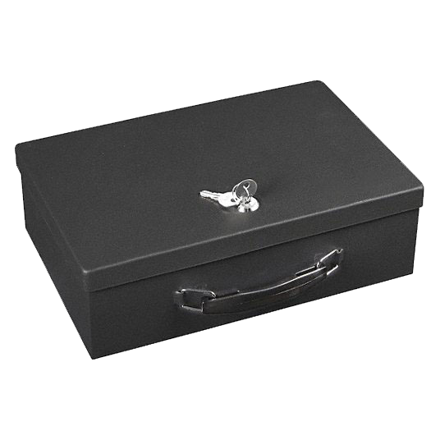
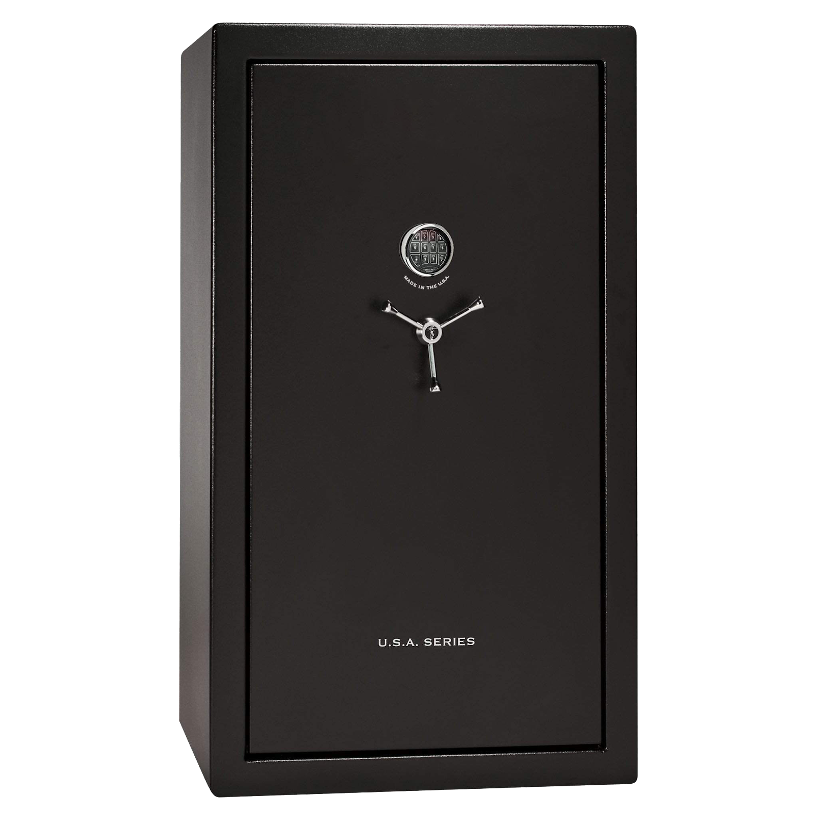
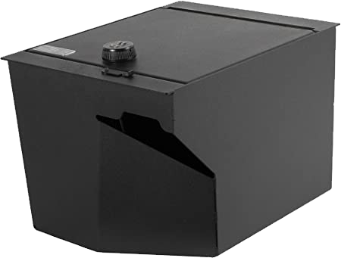
Full-Size Gun Safe
Storage of multiple guns in one place. Biometric lock more secure than key or passcode.
$200-$2,000
Lock Box/Locker
Smaller and lighter than safe. Biometric lock more secure than key or passcode.
$25-$350
Console/Vehicle Gun Safe
For storage in a vehicle. Biometric lock more secure than key or passcode.
$50-$350
Prevents access by children
Prevents access by unauthorized users
Prevents theft (if secured to a structure in home)
Enables fast access
Prevents access by children
Prevents access by unauthorized users
Provides secure vehicle storage
Enables fast access
Prevents access by children Prevents access by unauthorized users
Prevents theft (if secured to a structure in car)
Provides secure vehicle storage
Enables fast access
BeSMARTforKids.org
Notes:
SLIDES 12 & 13 - We know that you may have specific questions about what Secure Storage looks like in practice—so here are some examples (we also have a handout that you can download at BeSMARTforKids.org/resources).
Contrary to popular belief, locking up guns does not prevent owners from readily accessing their guns. There is a common myth that storage devices negate the self-defense purpose of owning a gun by putting time-consuming barriers between the gun owner and their means of defense.
The reality is that there are many affordable options for secure gun storage that provide owners with access to guns in a matter of seconds while still preventing access by children and people at increased risk of harming themselves or others.
Further, it is possible that unsecured guns may actually increase the likelihood of crime and violence through an increased risk of gun theft.
Locking up guns will help to reduce the risk of firearm suicide, unintentional firearm injury and also help to prevent firearm theft.
Did you know that at least two guns are stolen every 15 minutes?
It’s important to also remember to lock up any guns in cars too—more than half of stolen guns are taken from cars. Just putting a gun under a seat or in the glove compartment wouldn't be considered secure storage. There are car gun lock boxes available for purchases at most retail and sporting goods stores.

Slide 13
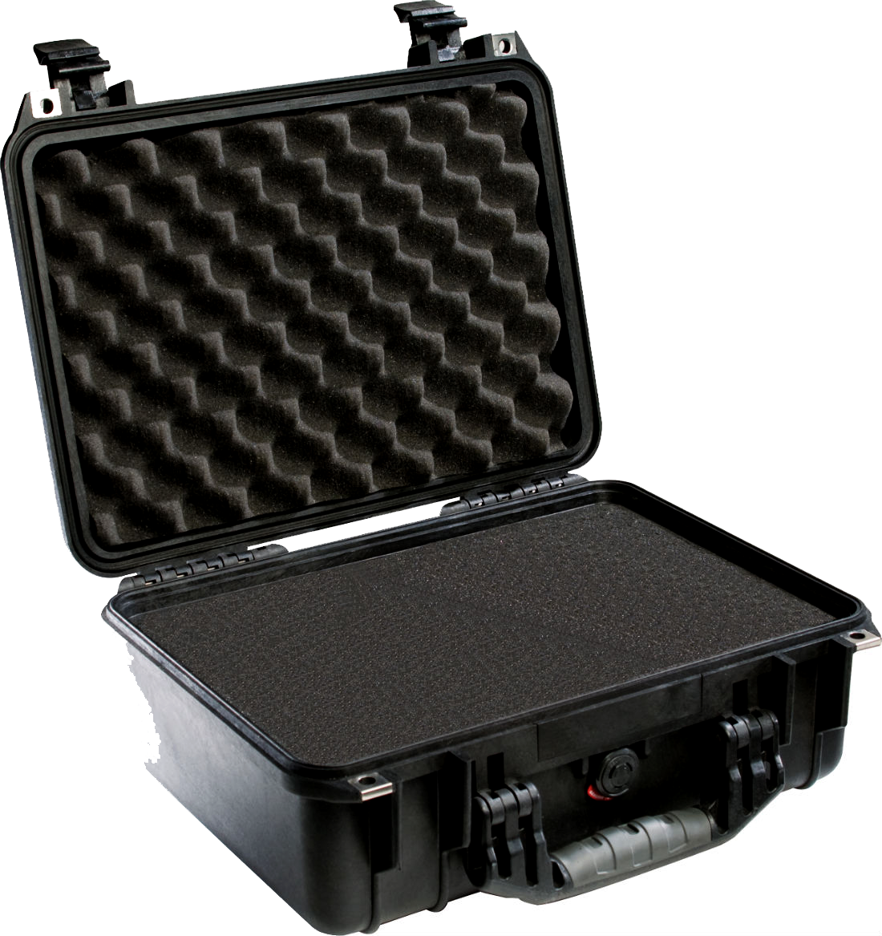
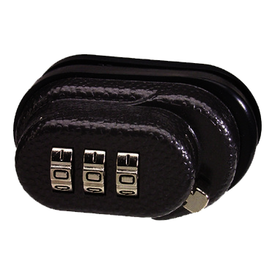
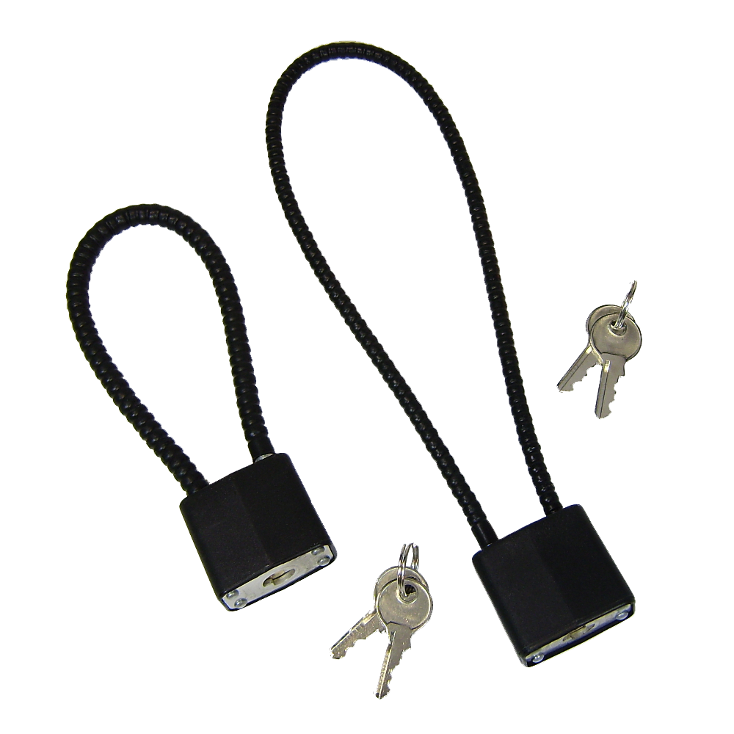
Gun Case
For home or in-transit storage of one firearm. Uses external lock $10-$150
Trigger Lock
Locks trigger of single weapon. Never use with loaded gun. May be dismantled with minimal tools and skills, so not as effective with older children and teens.
$10-$75
Cable Lock
Cable runs through action of single weapon to prevent firing. Ammunition must be removed for lock use. May be dismantled with minimal tools and skills, so not as effective with older children and teens.
$0 -$50
Prevents access by children
Prevents access by unauthorized users Enables fast access
Prevents use by small children
Enables fast access
Prevents use by small children
Enables fast access
*Often provided free with firearm purchase.
BeSMARTforKids.org

Slide 14
M
Model Responsible Behavior
It is always an adult’s responsibility to prevent unauthorized access to guns, not a curious child’s responsibility to avoid guns
Make it a part of the normal safety conversation you have with your children
Keep the language simple; for example: “If you see a gun, don’t touch it. Tell an adult right away.”
BeSMARTforKids.org
Notes:
SLIDE 14 - “M”, Model responsible behavior: Every law-abiding adult has the right to decide whether or not to have a gun in the home. But, you can’t rely on curious kids not to find a gun.
Kids know where their parents store their guns, and more than one-third reported handling their parents’ guns, many doing so without the knowledge of their parents—Nearly a quarter of parents did not know that their children had handled the gun in their house.
It is always an adult’s responsibility to prevent unauthorized access to guns, not a curious child’s responsibility to avoid guns. Talk to your kids about gun safety, but remember that’s a precaution, not a guarantee. One study found that young children who go through a week-long gun safety training are just as likely as children with no training to approach or play with a handgun when they find one.
Modeling responsible behavior means that SMART adults make sure that kids don’t have the opportunity to access guns.
That said, you can’t control the environment that your child is in all the time, so you should teach them not to touch a gun if they come across one, real or pretend, and give them the tools to get out of a dangerous situation, and to alert an adult. As an adult, it’s your responsibility to do everything you can to prevent them from getting in a dangerous situation to begin with.
We also have a handout on best practices for talking to children and teens about guns.

Slide 15
A
Ask About Unsecured Guns in Other Homes
Make it a part of your general safety conversation you have when sending your child to any home
Try email or text
4.6 million U.S. children live in a household with at least one loaded, unlocked gun
BeSMARTforKids.org
Notes:
SLIDE 15 - As we have mentioned, there are approximately 4.6 million US children living in a household with at least one loaded, unlocked gun.
That’s why you need to Ask about firearms in other homes your child visits, the “A” in SMART.
For the parents and caretakers in the room, what are some things you ask about before allowing your child to go to a friend’s or another home? Take several answers.
Suggestions:
Potential allergens/pets in the home
Pools on the property
Carseats for rides
Who will be home for playdate/teen events
TV and screen time/electronics/video games
Alcohol access

Slide 16
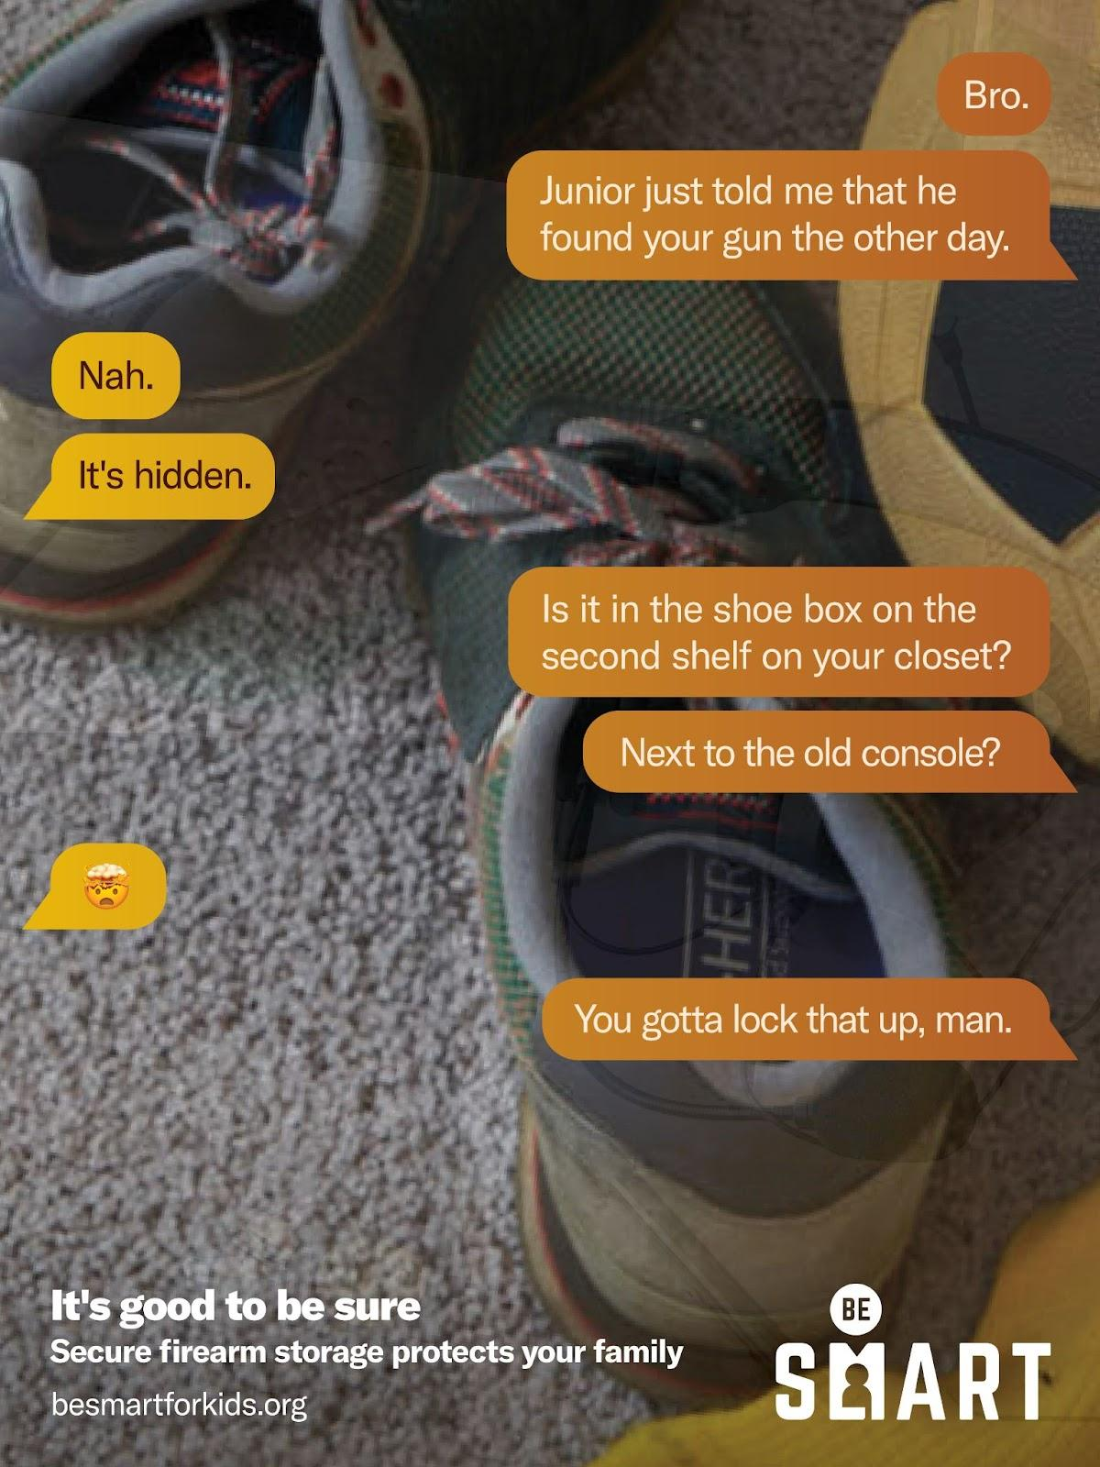
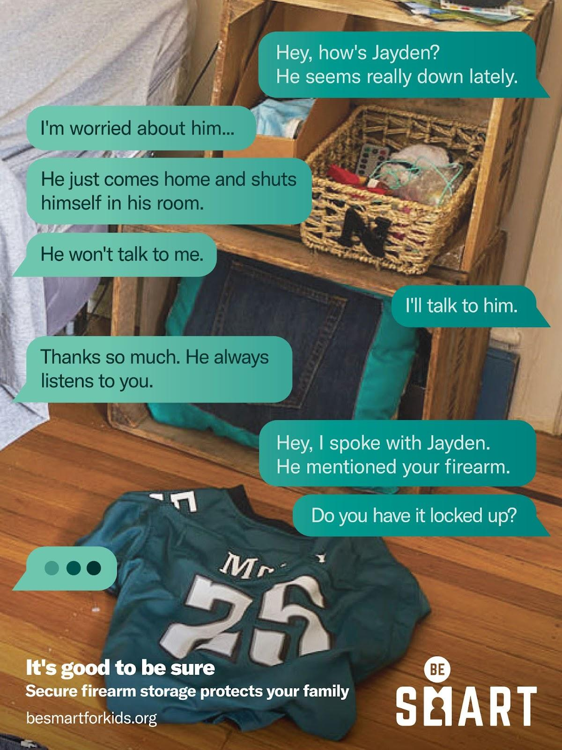
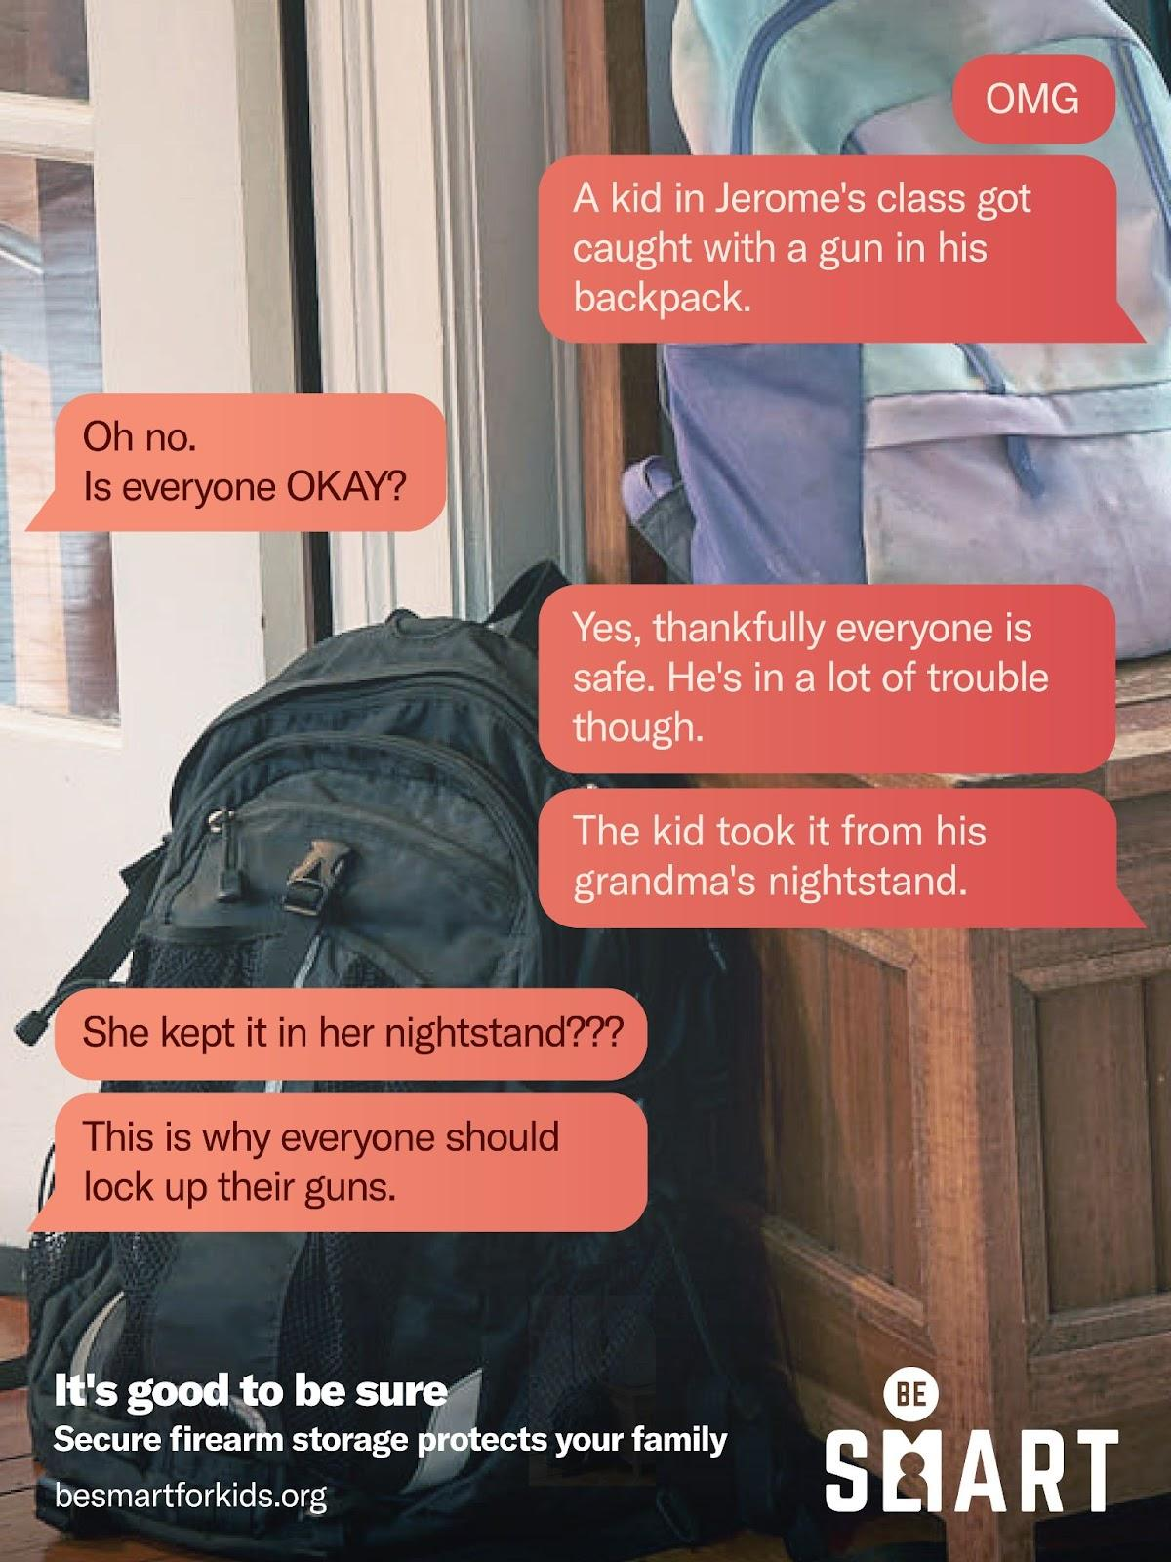
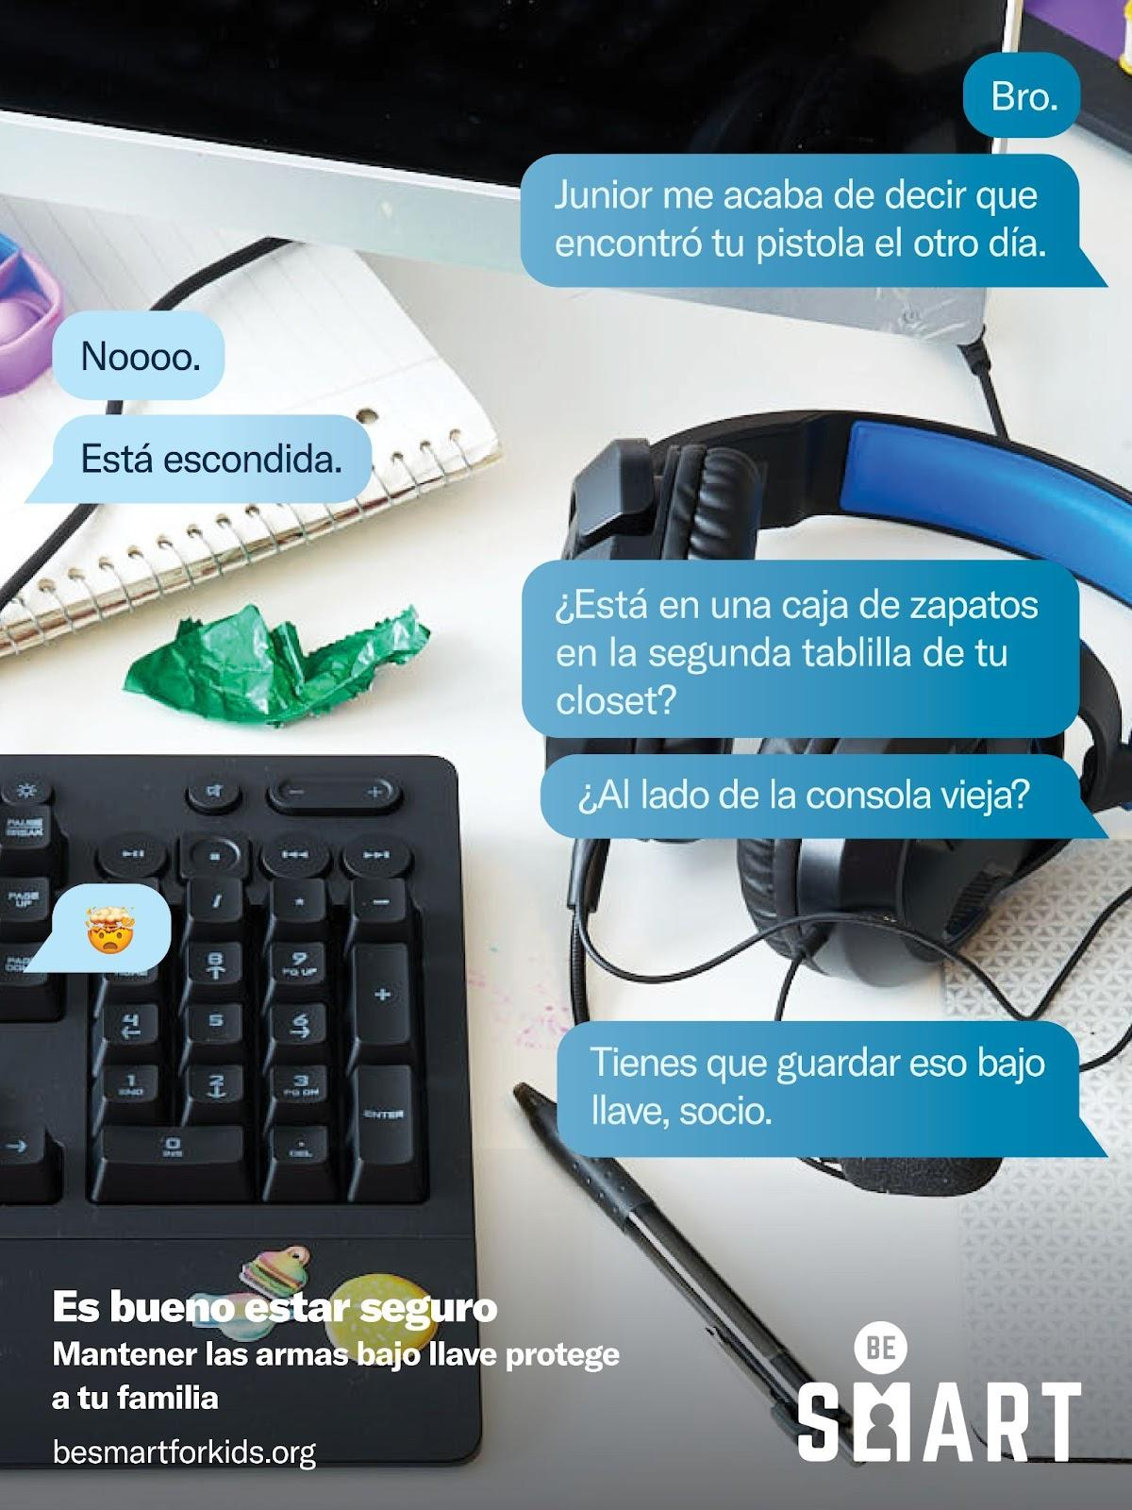
Be SMART Campaign
BeSMARTforKids.org
Notes:
SLIDE 16 - Asking about guns in the home should be as natural as asking about any other safety issue, if it seems awkward at first, try making it part of your general safety conversation. You might try asking via email or text if you’re uncomfortable at first.

Slide 17
R
Recognize the Role of Guns in Suicide
Most people who attempt suicide do not die–unless they use a gun
90% of suicide attempts with a gun result in death–a much higher fatality rate than any other means of self harm
This contributes to the fact that 41 percent of child suicides involve a gun
BeSMARTforKids.org
Notes:
SLIDE 17 - Let’s talk about Recognizing the role of guns in suicide, the “R”. Access to a gun can mean the difference between life and death.
As our children get older, you may need to consider taking another look at your storage methods. If you’ve been using a simple cable lock, you may want to think about getting a gun safe. We all know how curious children can be, so as they get older and more resourceful you will need to act accordingly.
Also, if you know your loved one is in distress, you might want to consider temporarily removing a gun from your home.
Why would you want to do that?
It’s important to consider that firearm suicide is uniquely lethal—90 percent of suicide attempts using a gun end in death and that half of suicides in the US are gun suicides; 70 percent of people who survive a suicide attempt will never attempt suicide again.
So, if you consider temporarily removing a gun from your home. How can you do that? Where can you bring it?
Local law enforcement may be willing to temporarily store your guns.
Some licensed gun dealers or gun ranges may be willing to temporarily store your guns.
Or, you could temporarily store your guns in the home of a friend or family member. To manage risk for that friend or family member, you should lock any guns that you transfer, and not provide the key or code. Depending on the law in your state, the person agreeing to store your guns may first need to get a background check at a gun dealer or through law enforcement.
Most people who attempt suicide do not die—unless they use a gun. In fact, 90 percent of suicide attempts with a gun result in death—a much higher fatality rate than any other means of self-harm. This contributes to the fact that 41 percent of child suicides involve a gun.

Slide 18
A survey of High School students found that 20% had seriously considered attempting suicide within the last year.
And one study showed that 41% of adolescents in gun-owning households report having “easy-access” to the guns in their home.
BeSMARTforKids.org
Notes:
SLIDE 18 - The national youth survey conducted by the CDC showed that 20 percent of high school students had seriously considered attempting suicide within the last year. One study showed that 41 percent of adolescents in gun-owning households report having “easy access” to the guns in their home. As we discussed earlier, research shows that secure firearm storage is associated with a decreased risk of child firearm suicide.

Slide 19
Resources Contact Info
National Suicide Prevention Line
1 (800) 273-8255
(24 hours/day)
988 Suicide & Crisis Lifeline
can be reached by calling or texting 988, or chatting on http://988lifeline.org
Trevor Project
The LGBTQIA+ Youth Suicide Prevention Line
Trevor Lifeline
1 (866) 488-7386
Text “Home” to 741-741
From anywhere in the United States, anytime, about any type of crisis
BeSMARTforKids.org
Notes:
SLIDE 19 - As mentioned at the beginning of our conversation, here are some important resources to write down or take a picture of in case you or someone you care about needs help.
Some Signs to look out for when concerned that a loved one may be suicidal:
● Prolonged sadness and depression
● Changes in mood or behavior
● Hopelessness
● Sleeping too much or too little
● Withdrawing/Isolation
● Aggression or agitation
● Increased alcohol or drug use
● Talking about killing themselves
We have handout materials with more information about how to get help if you do recognize these and other warning signs and it includes the Suicide Prevention Hotline. (Handout optional.) Additionally, if you are a survivor of gun violence, we have resources available at momentsthatsurvive.org/resources/ and https://everytownsupportfund.org/everytown-survivor-network/resources-for-victims-and-survivors-of-gun-violence/.

Slide 20
T
Tell Everyone You Know to Be SMART
Your voice, and all voices are critical. How will you commit to Be SMART today?
Consider at least THREE people that you want to share the Be SMART message with right now
Share Be SMART within your community
Text SMART to 64433 to learn more
BeSMARTforKids.org
Notes:
SLIDE 20 - “T” Tell! That is the POWER of Being SMART…
Volunteers have the option to change to photos of Be SMART w/their local Community Partners or as they see fit
Notes - So how will you commit to Be SMART today? Sharing the Be SMART message, the way we will save lives, is by spreading awareness—so I’d love for you to take just a few moments and think about who are you going to tell to Be SMART today?
Go ahead and text a friend right now if you want to…
Or think of 3 organizations that you think should hear this message…
Is there anyone that would like to share who they are going to tell to Be SMART?
You can also text SMART to 64433

Slide 21
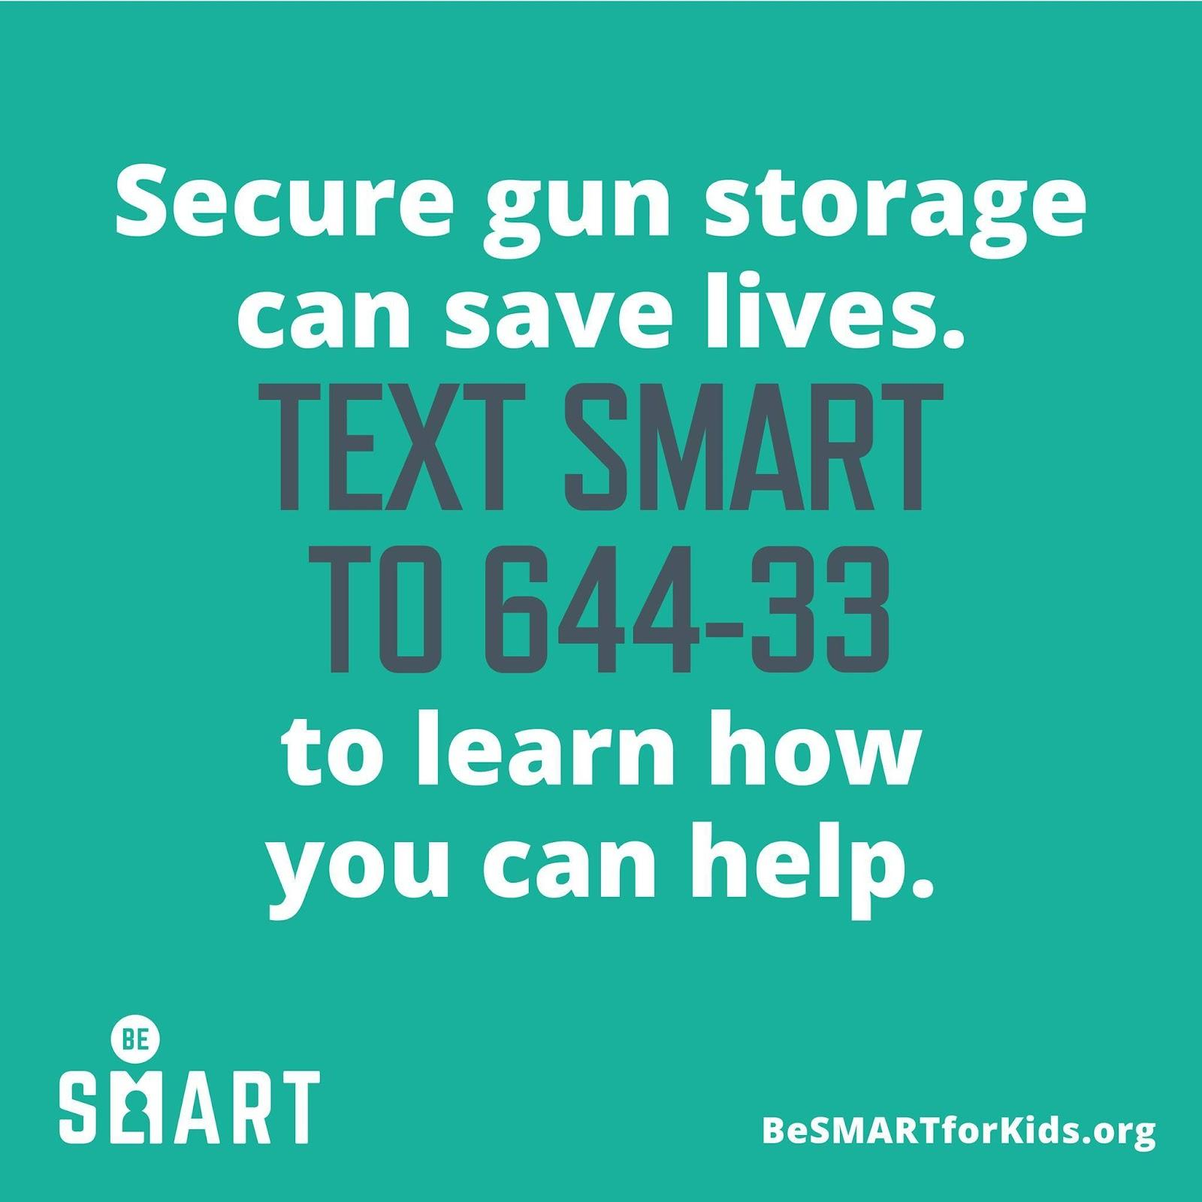
Contact Info
Virginia State BeSMART Lead
Dr. Hannah Hollon virginia@momschapterleaders.org
Alexandria BeSMART Co-Leads
Andrew Corso
Carrie Heath Phillips BeSmartALX@gmail.com
BeSMARTforKids.org
Notes:
Edit to add to your local contact information

Slide 22
Thank You!
Parent Teacher Association
Patrick Henry Elementary School
Alexandria City Public Schools
December 6, 2022
Andrew Corso
Carrie Heath-Phillips
Co-Leads Alexandria Be SMART
BeSMARTforKids.org

Slide 23
Speaker’s Endnotes
BeSMARTforKids.org
Notes:
Thank you so much for spending your time here today.
Just a reminder to fill out the sign-in form if you haven’t already.
Feel free to speak to me if you have any questions about the presentation or about gun safety in general.
The references slide is optional and provided in case anyone in the audience has questions about the sources for any of the content in the presentation.

